Slide 1

Communities Harnessing the Sun
SolSmart/ISEA Webinar
Zach Greene
Program Director, The Solar Foundation
September 6, 2018

Slide 2
Common Barriers to Solar
Notes:
The largest driver behind solar’s explosive growth over the past half decade has been shrinking costs. In places around the US where the cost of solar is prohibitive, solar doesn’t get installed.
Lack of education is also a cost. Solar companies have a harder time “selling” solar to customers who don’t have much experience with it, or who don’t see it in their communities.
Policy support can also impact costs positively or negatively. Incentives make solar affordable, but red tape makes solar more expensive by creating hurdles for installers that are passed along to consumers in the form of more expensive solar.
The program we’ll be presenting today is designed to address all of the hurdles listed here at the local level. And when local governments take a look at our technical assistance offering, they’re often left with a sense that their government has much more power to impact the local solar market context than they may have imagined.

Slide 3
The Cost of Solar PV
43% drop in price
2010 - 2015
As of Q2 2017: $2.84/W (SEIA)
Tracking the Sun VIII: The Installed Cost of Photovoltaics in the US from 1998-2014 (LBNL)
Notes:
Installed cost, on average, has fallen over 40% since 2010.
Installed cost $3.80/W for residential at end of 2015 (Tracking the Sun)
As low as $3.14/W for residential by Q2 2016 (SEIA)

Slide 4
The Cost of Solar in the US
Source: NREL (http://www.nrel.gov/docs/fy14osti/60412.pdf)
LBNL (http://emp.lbl.gov/sites/all/files/lbnl-6350e.pdf)(http://www1.eere.energy.gov/solar/pdfs/sunshot_webinar_20130226.pdf
Notes:
We still have a lot of room to shrink costs further, however.
For example, in 2013 the cost of solar in the US was over $2/Watt more expensive than it was in Germany.
If we begin to break down these costs, we see that the hardware costs, or the cost to purchase the equipment, is about the same is both places.

Slide 5
The Cost of Solar in the US
Source: NREL (http://www.nrel.gov/docs/fy14osti/60412.pdf)
LBNL (http://emp.lbl.gov/sites/all/files/lbnl-6350e.pdf)(http://www1.eere.energy.gov/solar/pdfs/sunshot_webinar_20130226.pdf )
Notes:
Where the major discrepancy arises are in the non-hardware costs. So what are these non-hardware costs?

Slide 6
The Cost of Solar in the US
Solar Soft Costs
Source: NREL (http://www.nrel.gov/docs/fy14osti/60412.pdf)
LBNL (http://emp.lbl.gov/sites/all/files/lbnl-6350e.pdf)(http://www1.eere.energy.gov/solar/pdfs/sunshot_webinar_20130226.pdf )
Notes:
The remaining 50% of the costs are commonly grouped together as “soft costs”. These soft costs include the cost of handling processes such as permitting and interconnect, marketing costs including customer acquisition, and installation costs including design, financing, and labor costs.
In the US, we pay a significant premium on these solar soft costs. And local governments play a critical role in reducing these soft costs.

Slide 7
The Cost of Solar in the US
No change in soft costs between 2010 and 2012
$3.32
Soft costs remain nearly 2/3s of installed cost
$3.32
$3.28
$1.90
Notes:
SunShot Goals by 2020
$1.50/W for residential systems
$1.25/W for small commercial systems
$1.00/W for utility scale systems

Slide 8
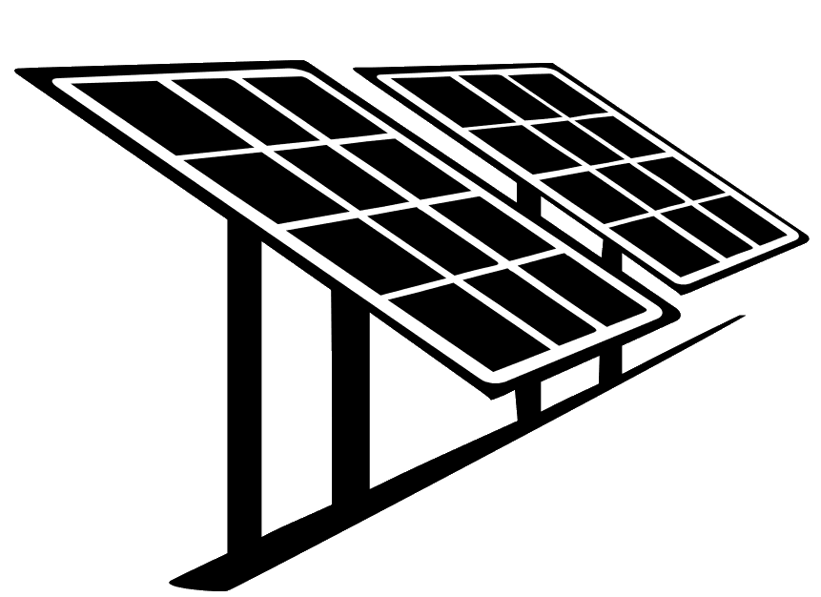


Benefits of Reducing Soft Costs
Streamlining local regulatory processes can reduce the cost of a typical system by $2,500. Onerous permitting procedures, for instance, can add $700 to the installed cost.
Reduced installation costs
Improved financials
Better “value proposition”
More solar
This is a good deal!
Sources: LBNL, IREC

Slide 9



Benefits of Reducing Soft Costs
Support American businesses
  8,601 U.S. businesses comprise the solar value chain. All but a handful are small businesses.
  Installers avoid multiple jurisdictions in their service areas based on onerous permitting.
Create American jobs
  There are over 250,271 solar workers in the U.S.
  Solar jobs have increased by 168% since 2010.
29.4 jobs
Residential solar
15.8 jobs
Non-residential solar
2.8 jobs
Utility scale solar
Sources: Clean Power Finance (Spruce); The Solar Foundation

Slide 10
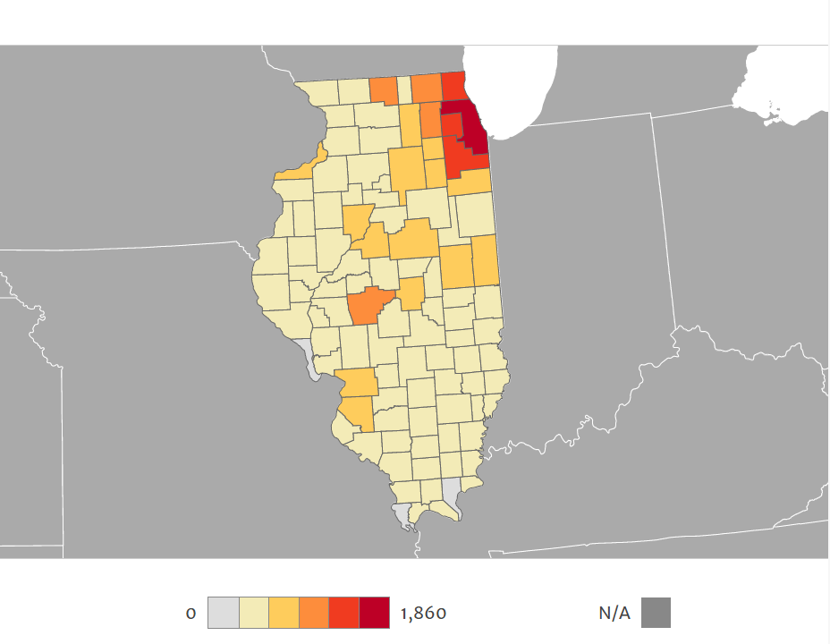
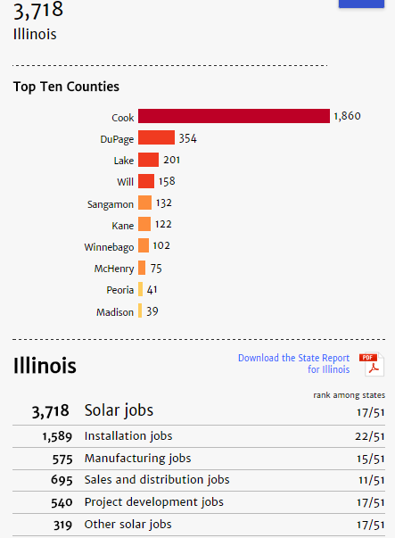
Solar Means Jobs
Learn more at: solarstates.org
Sources: 2016 Solar Jobs Census. The Solar Foundation.
Notes:
Solar’s nationwide effects
Added $84 billion to the GDP
1 solar job → 2.03 jobs elsewhere in the economy
$1 spent on solar → $1.47 in additional spending economy-wide

Slide 11
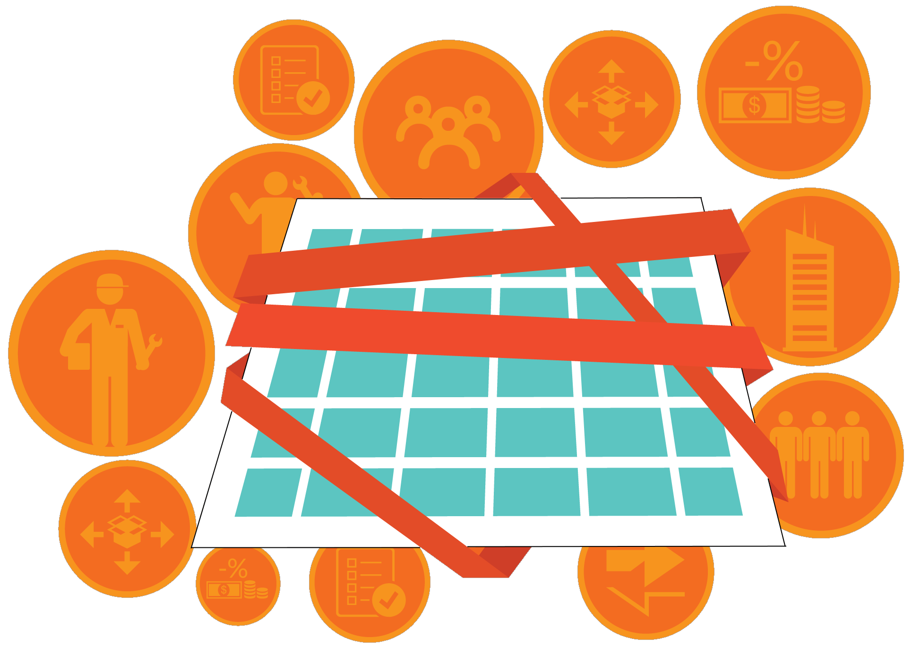


Takeaways
Soft costs often comprise a larger share of total installed cost than hardware and they slow solar market growth.
Soft costs can artificially shrink the number of places where solar is financially viable, thereby denying communities the economic benefits related to solar.
Local governments have a key role to play in reducing barriers.

Slide 12


Slide 13
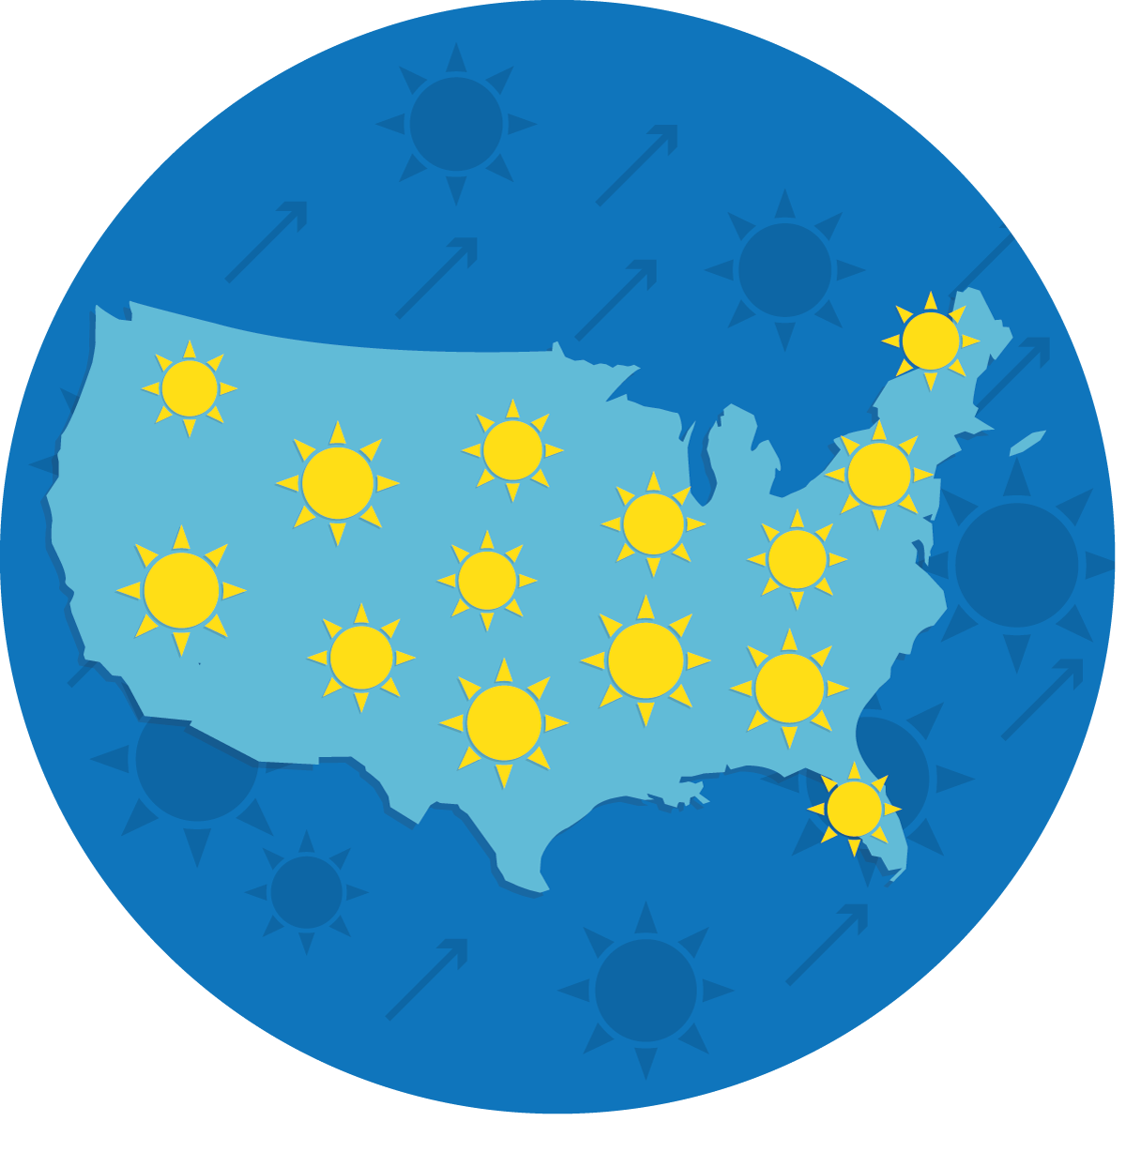
SolSmart Goals & Overview
To make it faster, easier, and more affordable for more Americans to choose solar energy, SolSmart will recognize at least 300 U.S. local governments with a nationally prestigious solar designation.
Designation
Technical Assistance
Earn Bronze, Silver, or Gold designation based on solar-related actions.
Demonstrate that the community is “open for solar business,” making it more attractive to solar industries.
Communities can receive no-cost technical assistance in 8 solar-related categories.
Solar experts will help review local processes, expand solar markets, and earn designation.

Slide 14

Program Structure

Slide 15




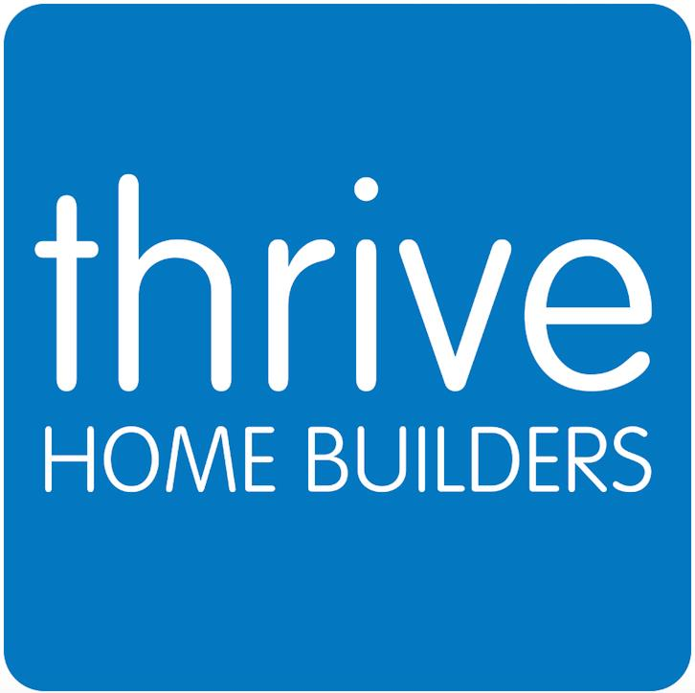


















Criteria Advisory Committee
Solar Possibilities
Consulting
Notes:
Adam Klinger, U.S. Environmental Protection Agency
Autumn Proudlove, NC Clean Energy Technology Center
Bill Brooks, Brooks Engineering
Brendan Reed, SolarCity
Brian Ross, Great Plains Institute for Sustainable Development
Bruce Plenk, Solar Possibilities Consulting
Chad Laurent, Meister Consultants Group
Chad Tudenggongbu, ICLEI
Emily Dodson, ICMA Center for Sustainable Communities
Garrett Fitzgerald, Urban Sustainability Directors Network
Gene Myers, Thrive Home Builders
Georgia Nesselrode, Mid-America Regional Council
Isabelle Hazlewood, Connecticut Green Bank
Holmes Hummel, Clean Energy Works
Jacqueline Patterson, NAACP
Jayant Kairam, Environmental Defense Fund
Jason Coughlin, National Renewable Energy Laboratory
Jorge Madrid, Environmental Defense Fund
Joshua Huneycutt, U.S. Department of Energy
Kathryn Wright, Meister Consultants Group
Katie Walsh, Carbon Disclosure Project
Lee Rahr, Sustainable Northwest
Mike McKechnie, Mountain View Solar
Philip Haddix, The Solar Foundation
Randy Solomon, The Sustainability Institute at the College of New Jersey
Rebecca Cantwell, Colorado Solar Energy Industries Association (COSEIA)
Roxie Brown, The Solar Foundation
Riana Ackley, ICLEI
Ryan Cook, Meister Consultants Group
Taylor Markwith, National Association of Regional Councils

Slide 16
SolSmart Criteria
Designation and technical assistance is tied to these eight categories and their associated actions:
Foundational Categories | Special Focus Categories
Permitting | Solar Rights
Planning, Zoning, and Development Regulations | Inspection
 | Construction Codes
 | Community Engagement
 | Utility Engagement
 | Market Development & Finance
Innovative Actions

Slide 17
SolSmart Criteria
Foundational Categories
PERMITTING
Implement permitting best practices to provide solar developers and installers a transparent, efficient, and cost-effective approval processes that also protects your community’s valuable staff time.

Slide 18
Permitting Example (P-1)
Create and make available an online checklist detailing the steps of your community’s solar PV permitting process
Why it’s important:
  Increases transparency around the permitting process and required submittals
  Precipitates a review of the current process and may lead to improvements
  Leads to better submissions from installers
  Enhances observability of solar energy

Slide 19
SolSmart Criteria
Foundational Categories
PLANNING, ZONING, & DEVELOPMENT REGULATIONS
Provide maximum siting options for rooftop and ground-mounted solar projects while preserving your community’s character and historic resources.

Slide 20
Planning, Zoning, & Development Regulations Action (PZD-4)
Provide clear guidance for solar PV in historic and special-use districts.
Why it’s important:
  Increases transparency for those living or owning a business within these districts
  Ensures community can maintain the aesthetic of these districts
  Precipitates a review of the current requirements
  May enable additional installations

Slide 21
SolSmart Criteria
Special Focus Categories
INSPECTION
Protect public health and safety while ensuring compliance with state and local codes.
CONSTRUCTION CODES
Adopt applicable codes and standards that provide clear guidance on solar installation requirements and solar-ready construction.
SOLAR RIGHTS
Protect the right to sunlight for current and future solar consumers through solar access ordinances or easements.
UTILITY ENGAGEMENT
Discuss and implement your community’s goals for solar energy, community solar, net metering, and interconnection with local utility.

Slide 22
SolSmart Criteria
Special Focus Categories Cont.
COMMUNITY ENGAGEMENT
Support local solar energy development through public education and engagement efforts, group purchase programs, and participation in state-level solar conversations.
MARKET DEVELOPMENT & FINANCE
Lead the way with solar installations on public facilities and grow the local solar market by providing information on, or expanding, local financing options and incentives

Slide 23
Special Focus Example (I-1)
Provide cross-training of inspection and permitting staff on solar PV via in-person or online resources. Training must have occurred within the past five years.
Why it’s important:
  Ensures staff understand the current best practices in permitting and inspecting solar PV
  Leads to examination of current processes and procedures
  Enables staff to feel more comfortable with solar energy
  Creates redundancies that are important when staff is out of the office or reductions in staff occur

Slide 24
Special Focus Example (SR-2)
Provide consumer protection resources on solar PV.
Why it’s important:
  Provides residents and businesses with an understanding of their rights and important considerations when installing solar
  Expands solar education – even beyond the basic consumer protection components
  Protects the local solar market by potentially eliminating bad actors

Slide 25
Special Focus Example (CE-4)
Support or host a community-group purchase program (e.g., Solarize).
Why it’s important:
  Lowers installation costs due to bulk purchasing
  Helps educate and engage the community
  Opportunity to expand access to underserved populations
  Increases observability of solar energy within the community

Slide 26
Special Focus Example (MDF-3)
Provide information to consumers about different solar PV financing options, including commercial options, such as Property Assessed Clean Energy (PACE) financing.
Why it’s important:
  Educates consumers about all potential financing options
  Helps signal appropriate types of financing
  May lead to additional solar installations
  Demonstrates local government support for solar

Slide 27
Don’t have jurisdiction?
Some communities do not have jurisdiction over permitting, planning and zoning, and/or inspection processes.
SolSmart created a “modified pathway” for entities (e.g. some counties) that is focused on convening and collaborating with local governments, while implementing best practices in areas within your control.

Slide 28




SolSmart Designation
Address Bronze prerequisites
Earn 20 points in Permitting
Earn 20 points in Planning, Zoning, & Development Regulations
Earn 20 total points across “Special Focus” categories
Earn SolSmart Bronze
Address Silver prerequisites
Earn 100 total points from actions across all categories
Address Gold prerequisites
Earn 200 total points from actions across all categories

Slide 29
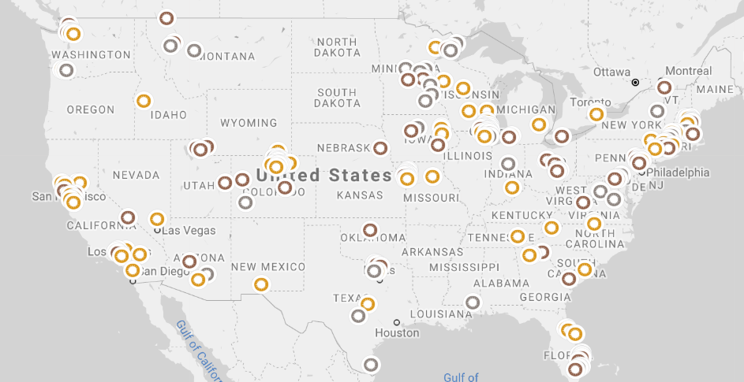
SolSmart Participants
260+ participating AHJs
213 current designees
Designees in 37 states
Over 61 million Americans

Slide 30

No-Cost Technical Assistance
All communities pursuing SolSmart designation are eligible for no-cost technical assistance from national solar experts.
TA providers have decades of combined experience in solar energy, along with thousands of hours of previous TA provision to municipal governments.
On average, a community can expect 100 hours of technical assistance.
TA eligible directly from SolSmart partner organizations (NREL, Cadmus, etc.) or through SolSmart Advisors

Slide 31
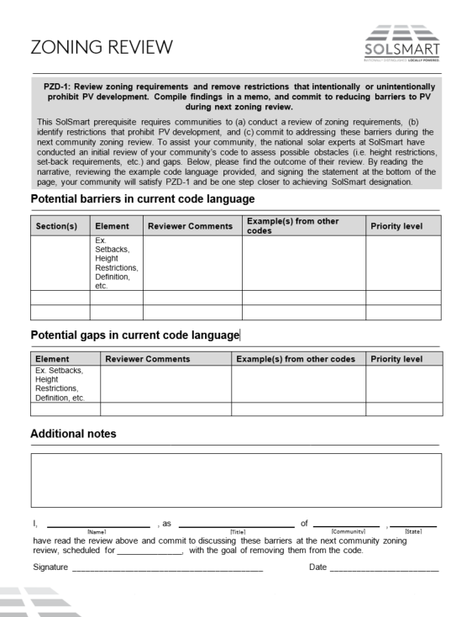
No-Cost Technical Assistance
TA provision through a variety of means:
Online
  Resource catalog
  Email
  Webinars
Over the Phone
  Clearinghouse calls
  Conference calls
In person
  Site visits
  Technical workshops/seminars
  Advisors
Peer-to-peer
STEP 1: Cut critical red tape via (3) prerequisites.
TA providers are creating templates to assist communities, and to provide them with a more transparent experience.

Slide 32

SolSmart Advisors
Program-funded temporary staff to help communities achieve designation.
Advisors evaluate existing local government standards, processes, and apply industry-leading best practices that move a community toward designation.
SolSmart Advisors assist communities through engagements lasting from six months to one year.
Equates to hundreds of hours of in-person technical assistance for communities receiving an Advisor.
Accessing local/regional expertise to further SolSmart’s soft cost reduction goals

Slide 33
SolSmart Advisors
Round 1: Individuals serving communities nationwide
  Oklahoma City, OK
  Philadelphia, PA region
  Providence, RI
  Atlanta, GA region
  And more…
Round 2: Individuals and organizations serving communities nationwide
  Great Plains Institute
  Midwest Renewable Energy Association
  City University of New York
  Metropolitan Mayors Caucus
  And more…
Notes:
Metropolitan Mayors Cohort
Provided zoning code review for all 18 communities
Provided framework to help municipalities review and improve permitting processes
Provided direct technical guidance bi-weekly to all communities and the Mayors Caucus

Slide 34
Peer Mentor Network
Engage online, over the phone, or at SolSmart events with “peer mentors” who have applied best practices in their own communities.
Peer Mentors include:
  Municipal/county staff
  Elected officials
  University and technical college staff
  Community leaders
  Solar professionals
Peer Mentors will be vetted and trained by SolSmart staff.
Benefits for Peer Mentors include travel stipends, SolSmart badges/awards, recognition on the SolSmart website, and other special perks.

Slide 35
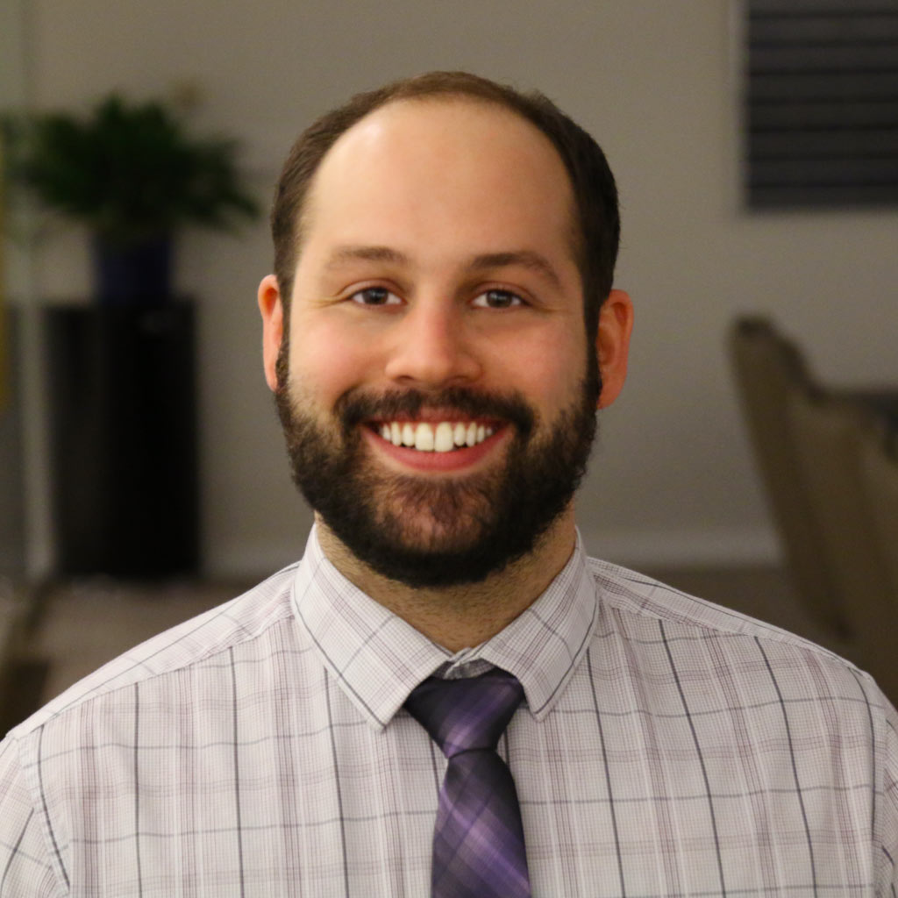
Q & A
Zach Greene
Program Director, SolSmart Technical Assistance Provider
The Solar Foundation
202-866-0895
zgreene@solarfound.org

Slide 36


Municipal Collaboration to Become SolSmart
Edith makra. Director of environmental initiatives Charles Dabah, Program Assistant
Notes:
Intro MMC

Slide 37










The Greenest Region Compact
49 Consensus Sustainability Goals in 10 Categories
Climate
Economic Development
Energy
Land
Leadership
Mobility
Municipal Operations
Sustainable Communities
Water
Waste
Notes:
Foundation for sustainability
Tool for getting things done

Slide 38

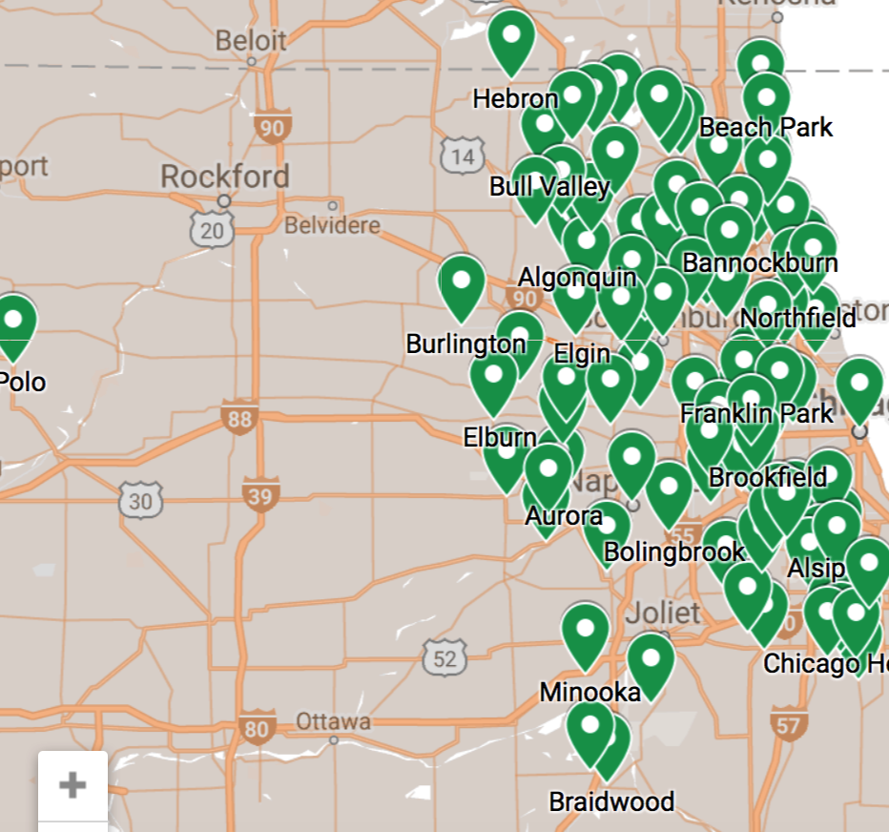
105 GRC Communities
10 Councils of Governments
5.2 million residents
Largest regional collaborative in US

Slide 39
GRC Sustainability
  Greenest Region Compact
    Endorse through municipal resolution
  GRC Framework
  Compilation of objectives and strategies to achieve GRC goals
  Supportive Programs to achieve goals
    Like SolSmart

Slide 40

GRC Framework aligns with SolSmart
Lead 18 municipalities to become
Sol Smart for streamlining solar codes & policies
Notes:
Guide me at the regional level
Know exactly what top priorities are
Mimics what munis do anyway – borrow from one another

Slide 41
MMC as SolSmart Advisor
Engage Greenest Region Compact (GRC) Communities
Secure commitment from leaders (solar statement = GRC)
Coach communities to complete tasks
Address tasks collaboratively
Organize participation in training
  IFIA Solar Plan Review training, IBEW Solar PV training, Cook County community solar meeting, ILAPA Planning for Solar Development training
Promote SolSmart and community leadership

Slide 42
Addressing Tasks Collaboratively
  Free flow of ideas via bi-weekly calls
  Sharing of best practices
    Permit fees, permit processing times, inspection times and frequencies
  Sharing of templates
    Permit checklists, solar landing webpages, draft language for changes to zoning code

Slide 43
 | BRONZE |  |  |  |  |  | SILVER |  |  |  |  | GOLD
Type of Action | Brookfield | Cook County | Glencoe | Hanover Park | Highland Park | Kane County | Darien | Hawthorn Woods | Richton Park | Schaumburg | South Barrington | Aurora | Beach Park | Chicago | Evanston | Park Forest | Will County | Total
Permitting
Post permit checklist online | 1 | 1 | 1 | 1 | 1 | 1 | 1 | 1 | 1 | 1 | 1 | 1 | 1 | 1 | 1 | 1 | 1 | 17
Process permits in 3 days or less |  |  |  |  |  |  |  |  |  |  |  | 1 | 1 | 1 | 1 | 1 | 1 | 6
Simplify permit application | 1 |  | 1 | 1 |  |  | 1 | 1 |  | 1 | 1 | 1 |  |  | 1 | 1 | 1 | 11
Set reasonable permit fees | 1 |  | 1 | 1 |  |  |  | 1 | 1 | 1 | 1 | 1 | 1 | 1 | 1 | 1 | 1 | 13
Streamline and expedite permit process |  |  |  | 1 |  |  | 1 |  |  |  | 1 | 1 | 1 |  | 1 |  | 1 | 7
Adopt standaridized permit form |  |  |  |  |  |  | 1 | 1 |  | 1 | 1 |  |  | 1 | 1 |  | 1 | 7
Train permitting & fire staff | 1 |  | 1 | 1 |  |  | 1 | 1 | 1 | 1 | 1 | 1 | 1 |  |  | 1 | 1 | 12
Offer online permit processing |  |  |  |  | 1 |  |  |  |  |  |  |  |  |  |  |  | 1 | 2
Planning, Zoning & Development
Evaluate zoning rules that impede solar | 1 | 1 | 1 | 1 | 1 | 1 | 1 | 1 | 1 | 1 | 1 | 1 | 1 | 1 | 1 | 1 | 1 | 17
Consider zoning changes to advance solar |  |  |  |  |  | 1 | 1 | 1 |  | 1 |  |  | 1 |  |  | 1 | 1 | 7
Allow solar development by right in all major zones |  |  |  |  |  |  |  | 1 | 1 | 1 | 1 | 1 | 1 | 1 | 1 | 1 | 1 | 10
Integrate solar into community plans | 1 |  |  | 1 | 1 | 1 |  |  |  |  | 1 | 1 |  | 1 |  |  | 1 | 8
Provide guidelines for historic districts | 1 |  | 1 |  |  |  |  |  |  | 1 |  | 1 |  | 1 |  |  |  | 5
Train planning staff | 1 | 1 | 1 | 1 |  | 1 | 1 |  |  |  |  |  |  |  |  |  | 1 | 7
Clarify zoning ordiance for PV systems | 1 |  |  |  |  |  |  |  | 1 | 1 |  | 1 | 1 | 1 | 1 | 1 | 1 | 9
Inspection
Cross-train inspection and permit staff | 1 | 1 |  | 1 |  |  |  | 1 | 1 | 1 | 1 | 1 | 1 | 1 | 1 | 1 | 1 | 13
Streamline & expedite inspection process |  |  |  | 1 | 1 |  |  |  |  |  | 1 |  | 1 | 1 | 1 | 1 |  | 7
Inspect PV systems within 10 days | 1 |  |  | 1 |  |  | 1 |  |  | 1 | 1 |  | 1 |  |  |  |  | 6
Offer online inspection process |  |  |  | 1 | 1 |  |  |  |  |  |  | 1 |  | 1 |  |  | 1 | 5
Construction Codes
Update & clarify construction codes for PV | 1 |  |  |  |  |  |  | 1 |  |  |  |  |  |  |  |  | 1 | 3
Solar Rights
Understand state policies on solar rights |  |  |  |  |  | 1 |  | 1 |  | 1 |  |  | 1 |  | 1 |  |  | 5
Provide consumer protection information |  |  | 1 | 1 |  | 1 |  | 1 | 1 | 1 |  |  | 1 |  |  | 1 | 1 | 9
Utility Engagement
Engage with utilities on solar programs |  | 1 |  |  | 1 |  | 1 | 1 | 1 |  | 1 |  |  | 1 | 1 | 1 | 1 | 10
Collaborate with utilities & regional partners |  | 1 | 1 | 1 | 1 |  | 1 | 1 |  | 1 | 1 |  | 1 | 1 | 1 |  |  | 11
Community Engagement
Host a solar web page |  |  | 1 | 1 |  | 1 |  | 1 | 1 | 1 |  |  | 1 | 1 | 1 | 1 | 1 | 11
Communicate with consitituents about solar |  | 1 |  | 1 | 1 | 1 |  |  | 1 | 1 | 1 |  |  | 1 | 1 |  | 1 | 10
Participate in regional solar goal-setting |  | 1 | 1 | 1 | 1 | 1 | 1 |  | 1 | 1 | 1 | 1 | 1 | 1 | 1 | 1 | 1 | 15
Post an community-level solar map |  | 1 |  | 1 |  | 1 |  |  |  | 1 |  |  | 1 |  | 1 | 1 | 1 | 8
Market Development and Finance
Connect to local solar installers |  |  |  | 1 |  |  |  |  |  | 1 |  |  | 1 |  | 1 | 1 | 1 | 6
Provide information about financing solar |  | 1 | 1 |  |  |  |  |  |  | 1 |  |  | 1 |  |  |  | 1 | 5
Assess feasibility of solar for public facilities |  | 1 |  | 1 |  | 1 |  |  |  | 1 |  | 1 |  |  |  | 1 | 1 | 7
Install solar on public facilities |  |  | 1 | 1 |  |  | 1 |  |  | 1 |  | 1 |  | 1 |  | 1 |  | 7

Slide 44
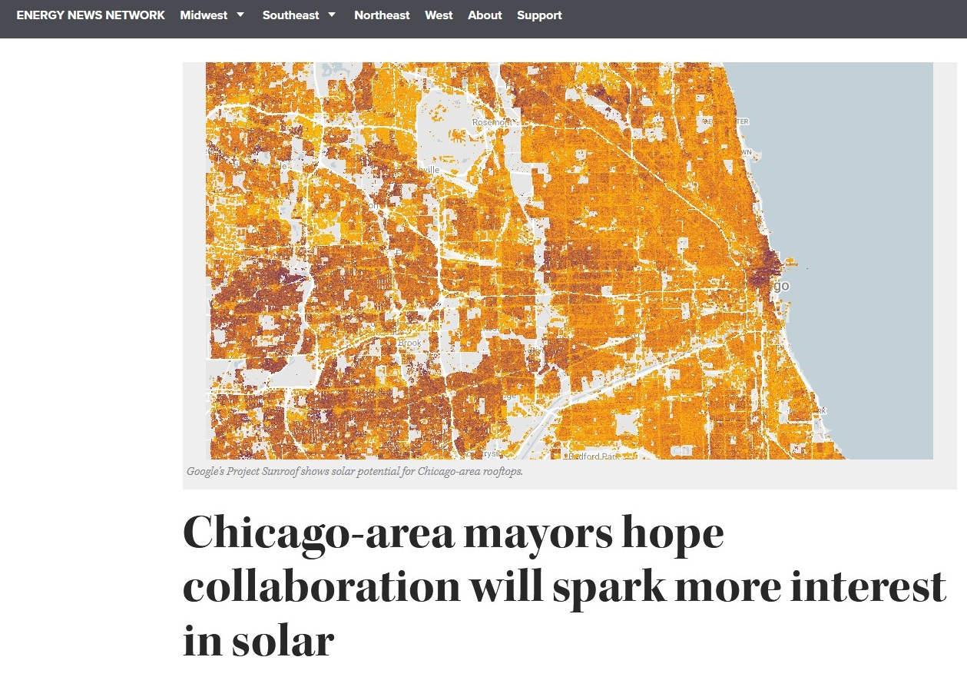
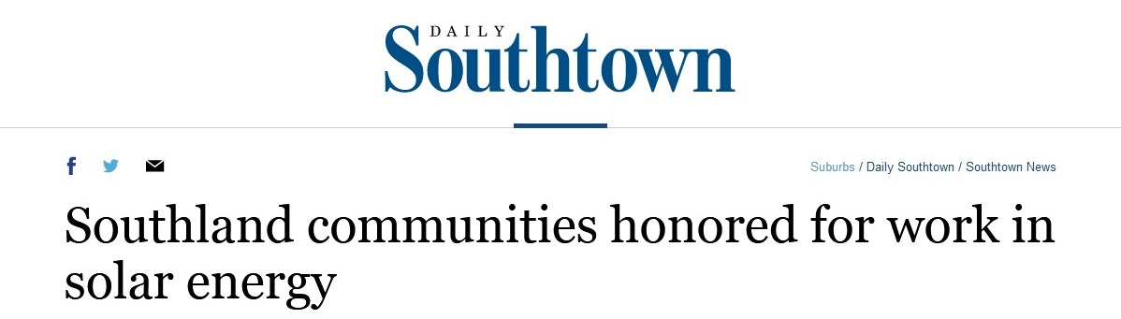
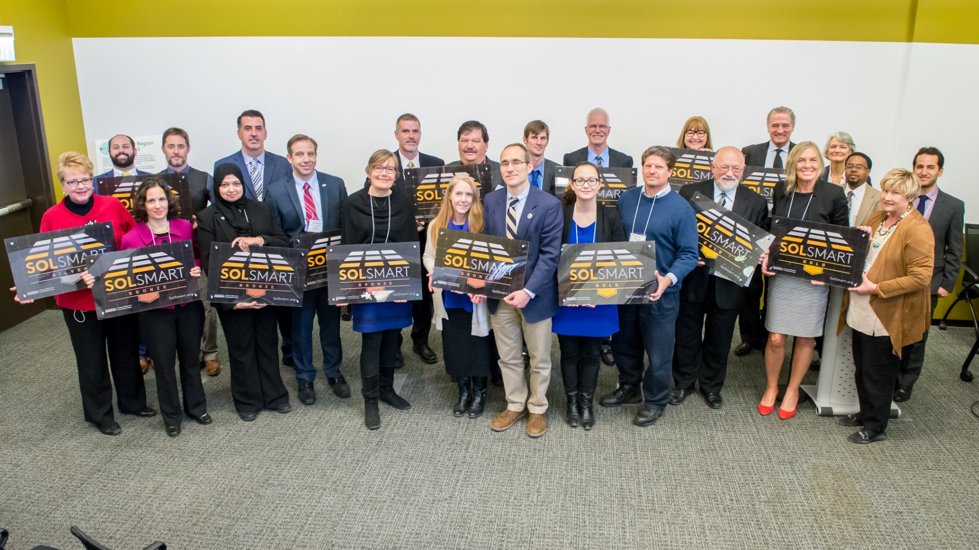
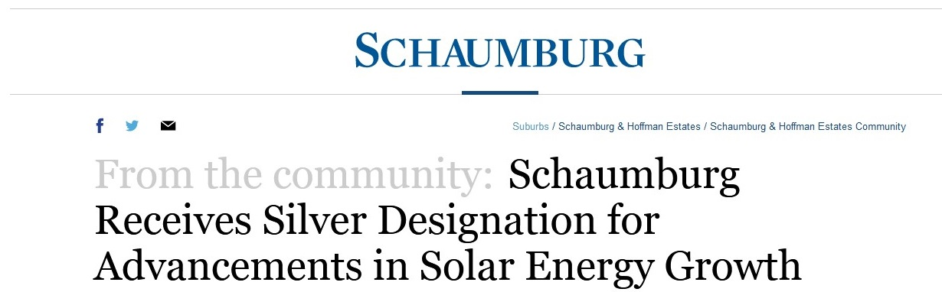
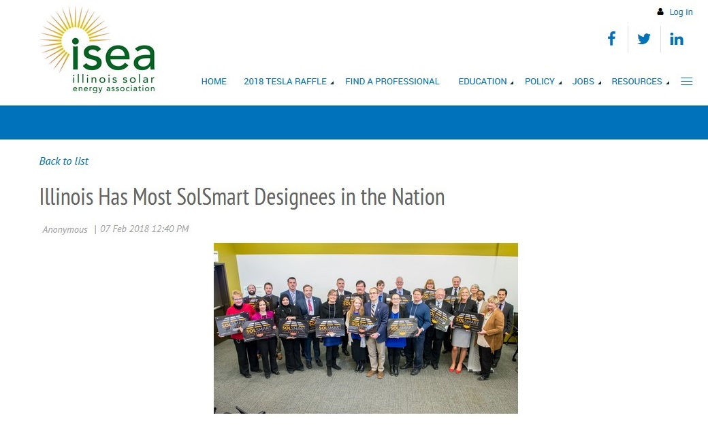

GRC Communities form largest cohort in the US
12 municipalities, 3 counties

Slide 45
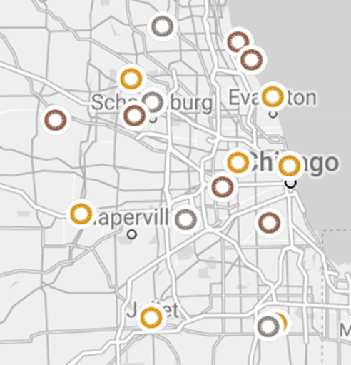
MMC SolSmart Communities
Starts Nov 1 2018

Slide 46
Schaumburg
SolSmart Silver
Martha Dooley
Landscape and Sustainability planner

Slide 47
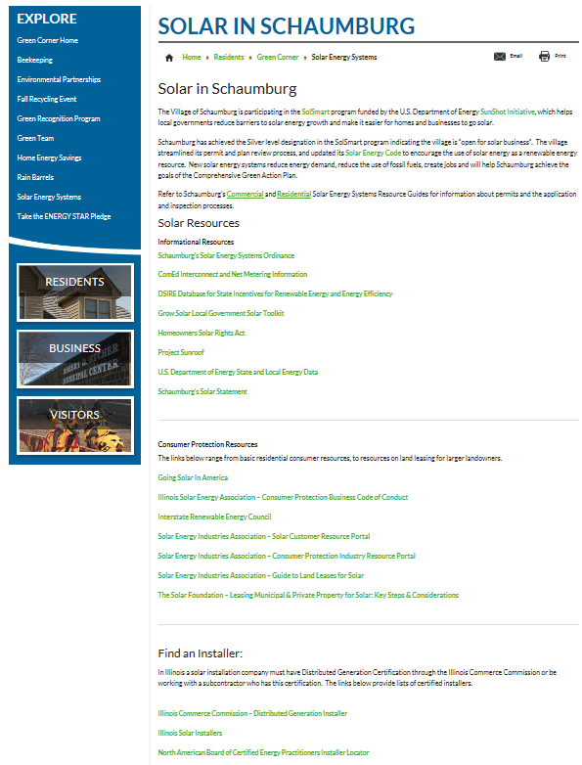

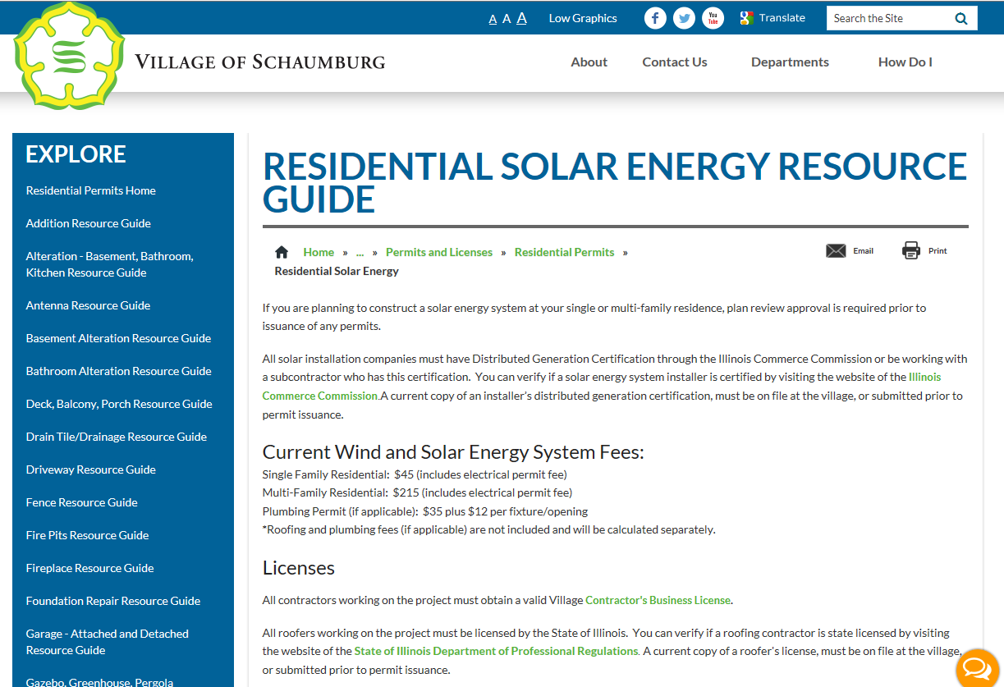


Slide 48
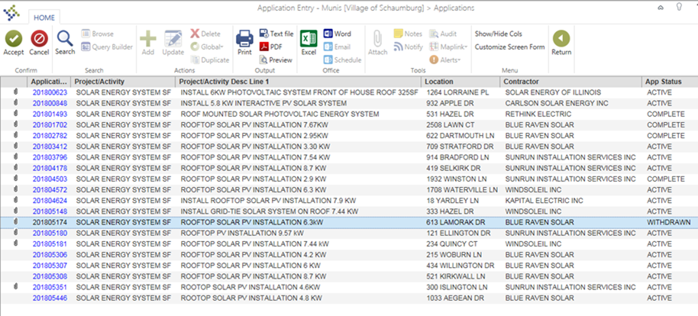

2018 Successes
20 Residential Applications (118.41 KW; Average Size 6.23 KW)
5 Commercial Residential Applications (1,820 KW)
IKEA – 867 KW
Rabine Paving – 69 KW
Target – 702 KW
Fairfield Inn and Suites - 91 KW
Towneplace Suites – 91 KW

Slide 49
Will County
SolSmart Gold
Samantha bluemer
Energy and Conservation Specialist

Slide 50

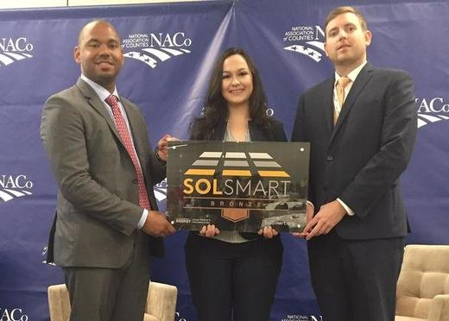

Solar in Will County
IKEA 2.9MW
Magid 3.9MW
Will County Courthouse
Park districts, schools, churches, residents
  Plainfield Park District (Net zero building)
  Valley View School District (5 school rooftops)
  Troy School District (6 school rooftops)
  Solar Farms (Crete/Beecher Township)
SolSmart GOLD 2017

Slide 51
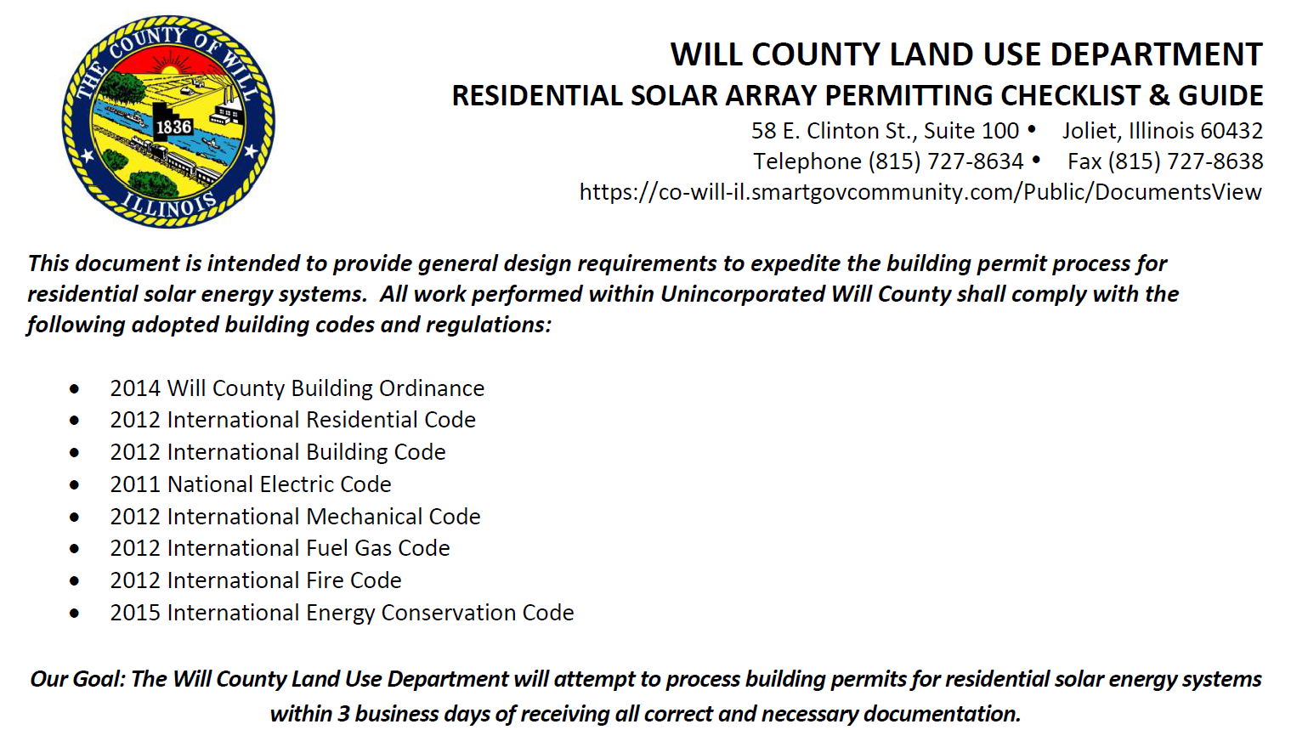
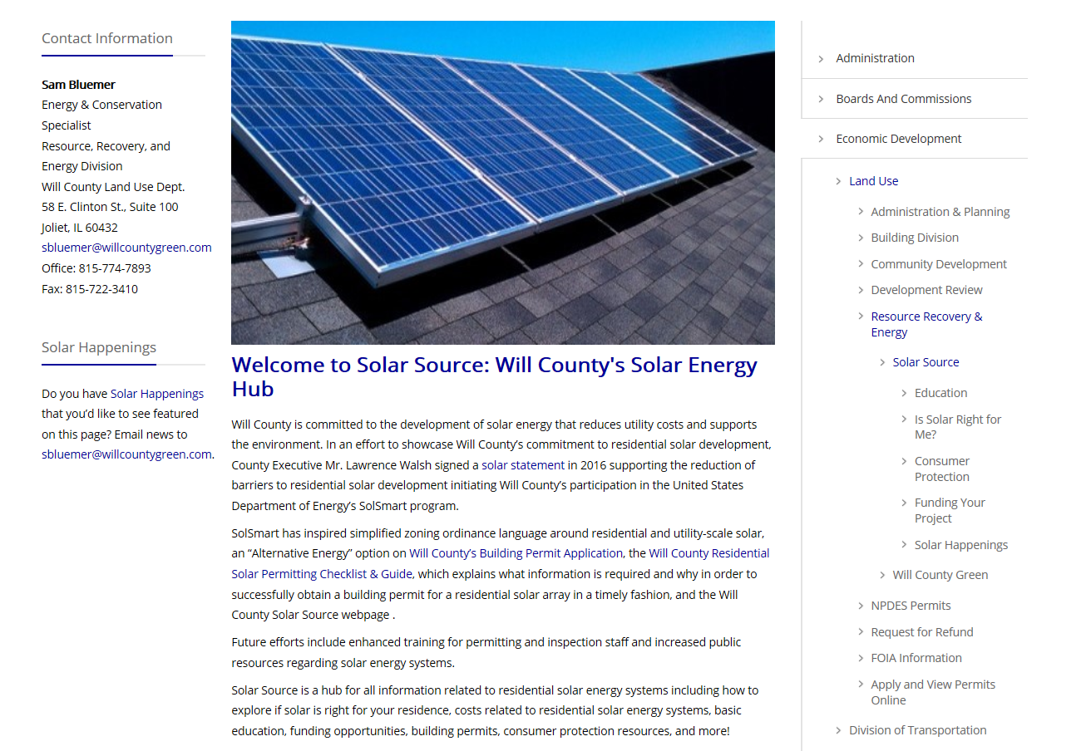
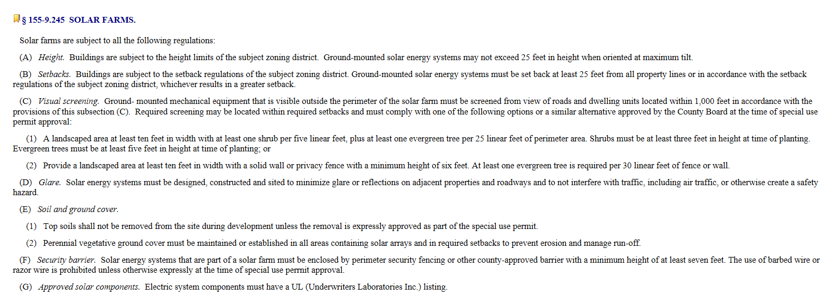
Fueling Solar Power
Residential Solar Permitting
Checklist and Guide
Will County Solar Source
Solar farm zoning language

